Slide 1
X-Path
TUTORIAL

Slide 2
What is XPath?
XPath is defined as XML path. It is a syntax or language for finding any element on the web page using XML path expression. XPath is used to find the location of any element on a webpage using HTML DOM structure. The basic format of XPath is explained below with screen shot.

Slide 3
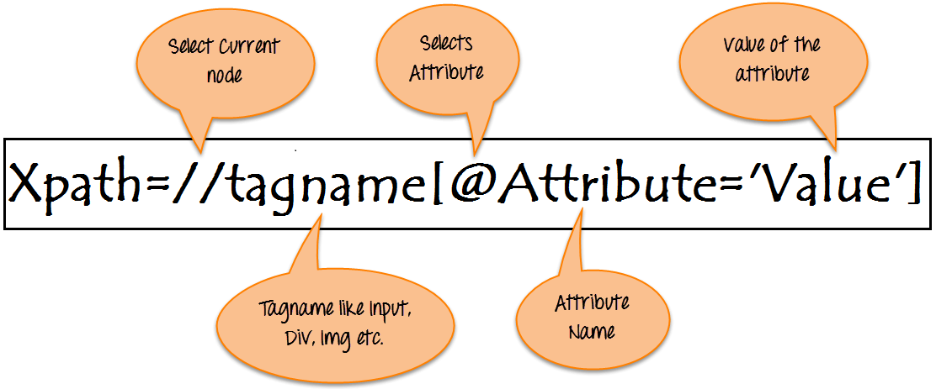
How does an Xpath looks like?
// : Select current node.
Tagname: Tagname of the particular node.
@: Select attribute.
Attribute: Attribute name of the node.
Value: Value of the attribute.

Slide 4
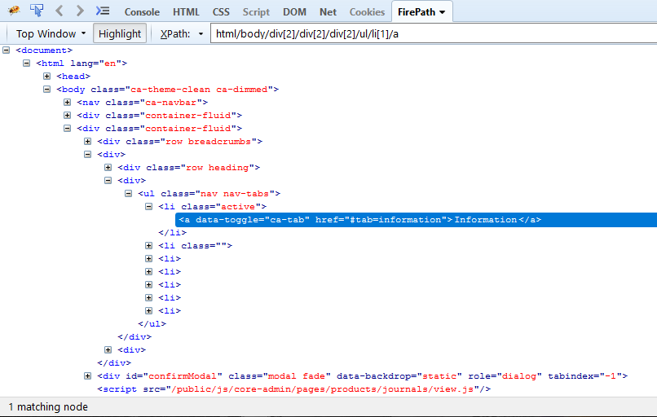
Which is which?
tagname? attribute?
value?
= a
= data-toggle
= ca-tab
//a[@data-toggle='ca-tab']

Slide 5
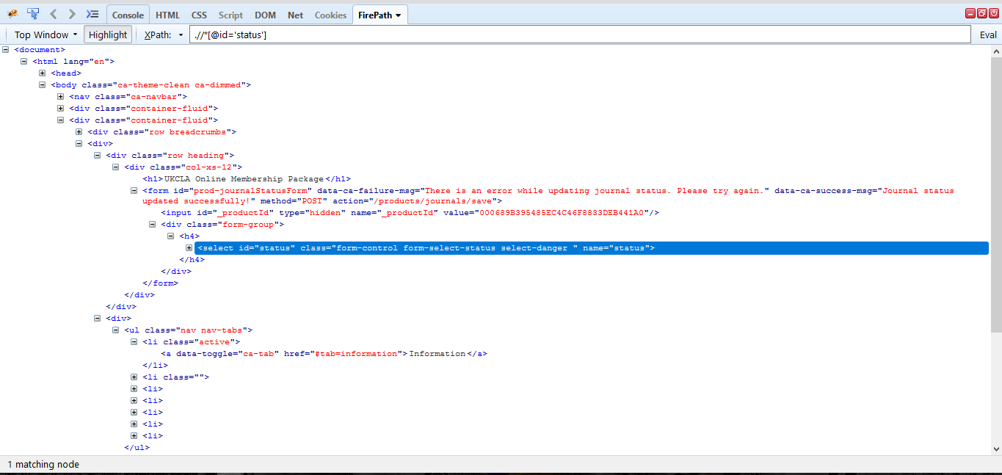
Tagnames
body
nav
div
form
input
ul
li
a
select
label

Slide 6
Attributes
class
id
data-toggle

Slide 7
Values

Slide 8
Types of XPath
1. Absolute XPath
It is the direct way to find the element,
But the disadvantage of the absolute XPath is that if there are any changes made in the path of the element
then that XPath gets failed.
2. Relative XPath
Path starts from the middle of the HTML DOM structure.
It starts with the double forward slash (//), which means it can search the element anywhere at the webpage.

Slide 9
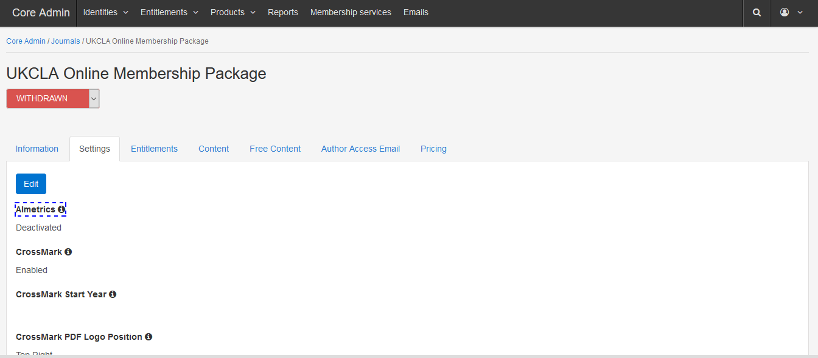
Sample

Slide 10
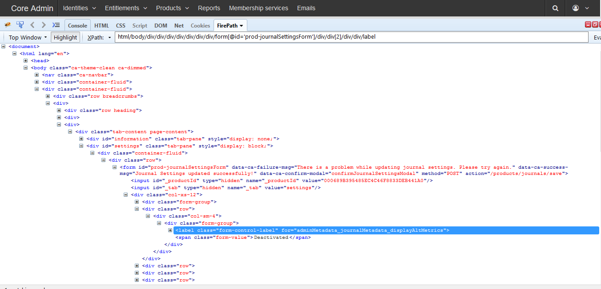
Sample

Slide 11
Sample
1. Absolute XPath
html/body/div/div/div/div/div/div/div/form[@id='prod-journalSettingsForm']/div/div[2]/div/div/label
2. Relative XPath
//label[contains(.,'Almetrics')]
Note: Best practice is never to use an absolute xpath in creating objects

Slide 12
Different Xpath
Basic Xpath
Contains
Using OR & AND
Start with Function
Text
Xpath axes
Following
Ancestor
Child
Preceding
Following-Sibling
Parent
Self
Descendant

Slide 13
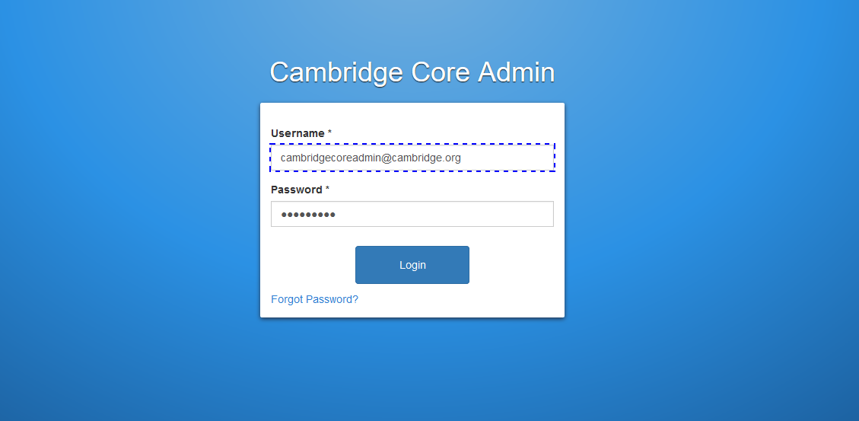
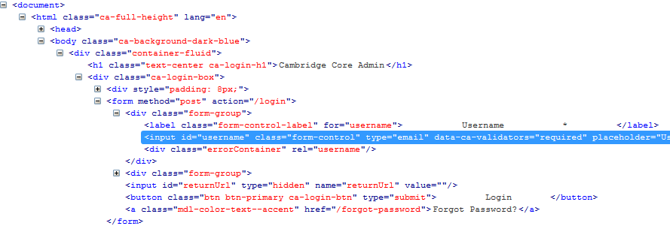
Basic Xpath
//input[@id='username']

Slide 14
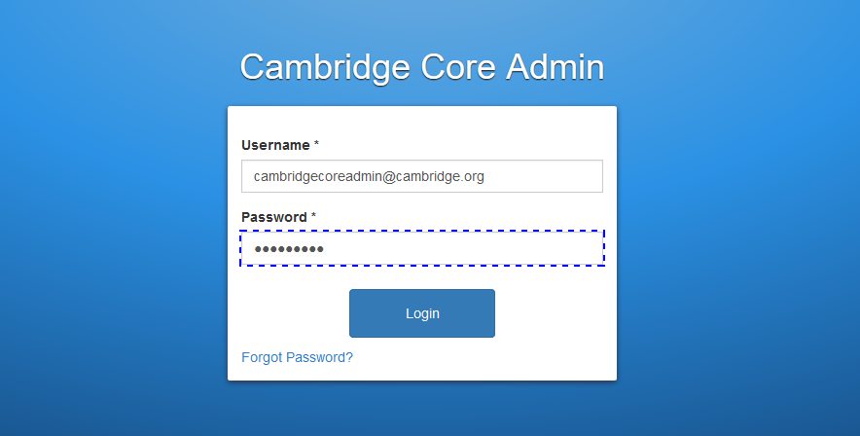
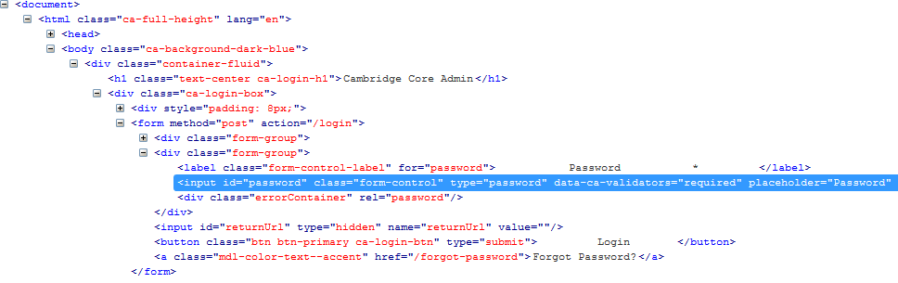
Basic Xpath
//input[@id='password']

Slide 15
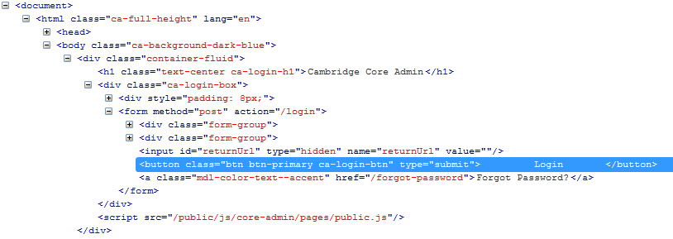
Basic Xpath
//button[contains(.,'Login')]

Slide 16
Some more basic Xpath expressions:
Xpath=//input[@type='text']
Xpath= //label[@id='message23']
Xpath= //input[@value='RESET']
Xpath=//*[@class='barone']
Xpath=//a[@href='http://demo.guru99.com/']
Xpath= //img[@src='//cdn.guru99.com/images/home/java.png']

Slide 17
Contains()
One of the most commonly used in Prime
Sample:
//table/thead/tr/th[contains(.,'Status')]
//section[contains(@class,'breadcrumbs-wrapper')]//ul[contains(@class,'breadcrumbs')]
//input[contains(@id,'firstName')]
//div[contains(@class,'flash-message')]//div[starts-with(@class,'alert')]
//div[@class= 'aop-cms']//following::div[contains(@class, 'page-not-found')]

Slide 18
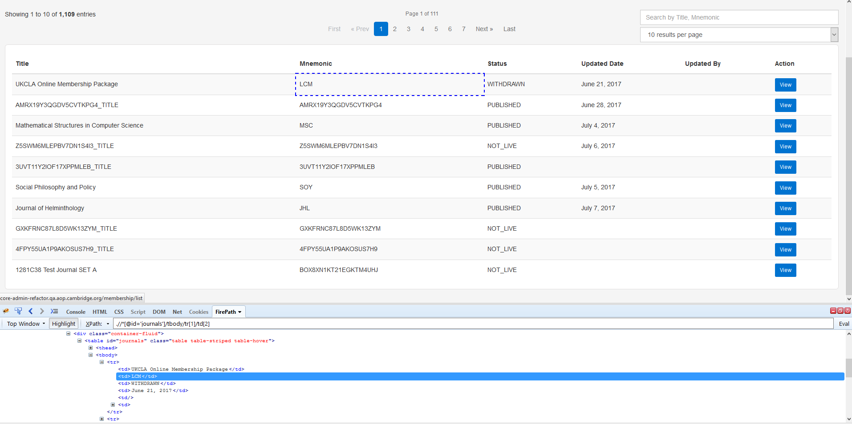
Sample of Contains()
//*[@id='journals']/tbody/tr[1]/td[2]
//table[@id='journals']//td[contains(.,'LCM')]

Slide 19
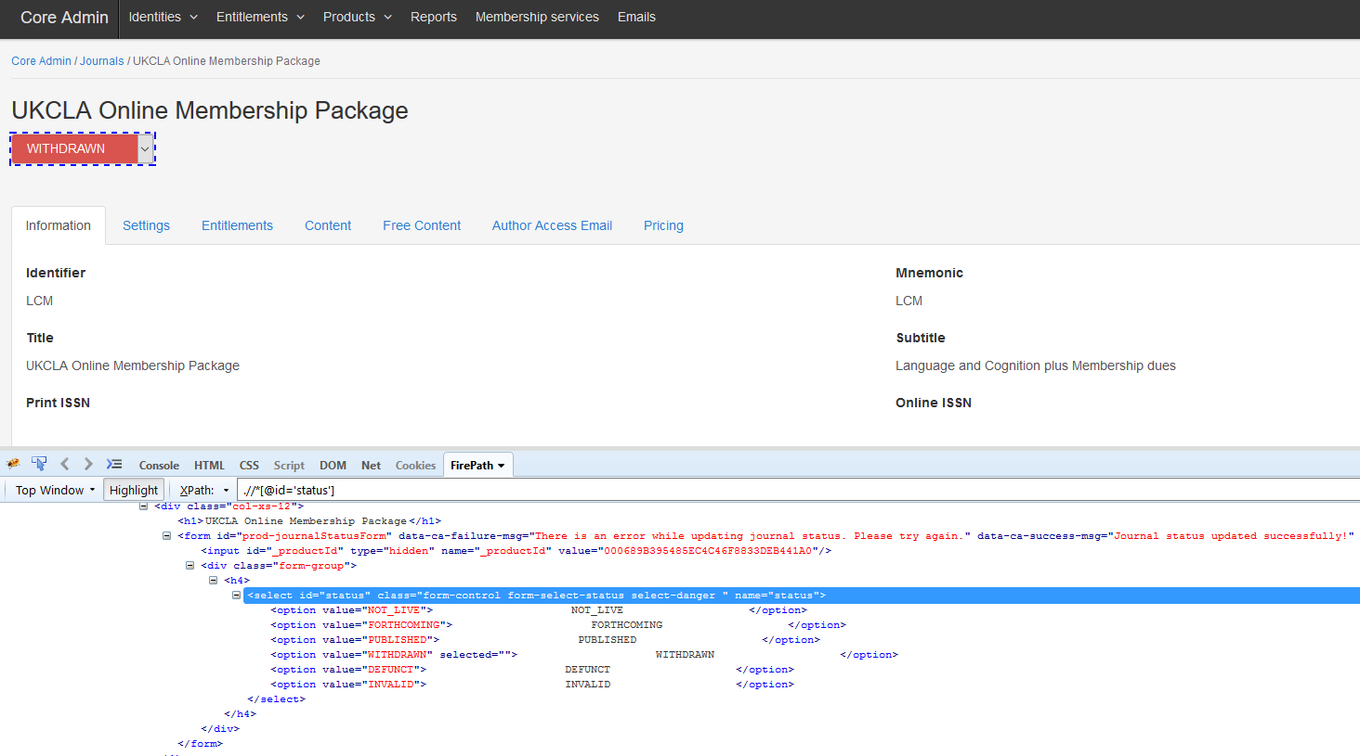
Sample of Contains()
//option[contains(.,’NOT_LIVE’)]
//option[contains(@value,'NOT_LIVE')]
//option[normalize-space(.)= 'NOT_LIVE']

Slide 20

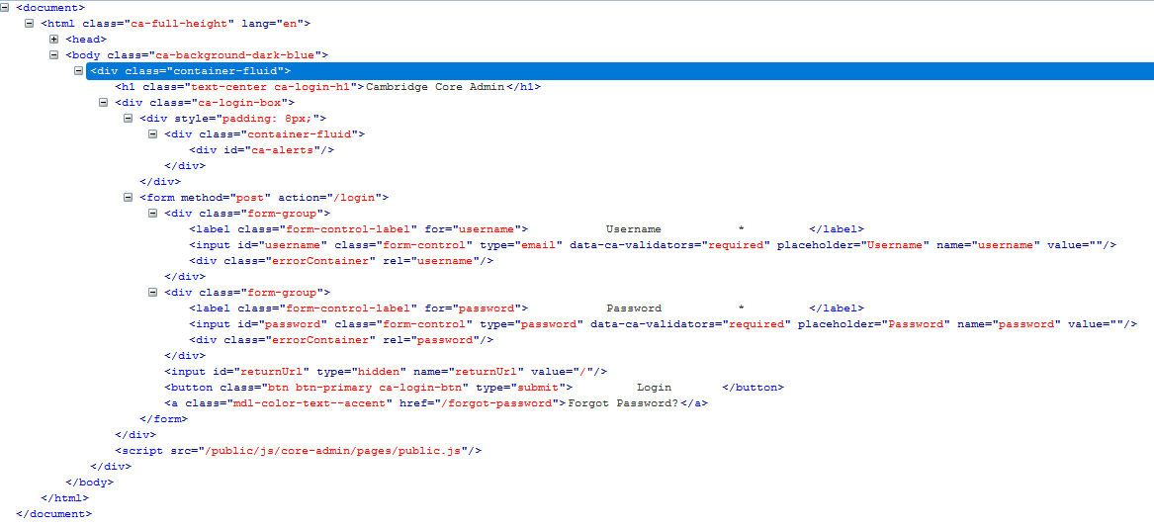
Some Possible Issue using Contains()
//label[contains(@class,'form-control-label')]

Slide 21

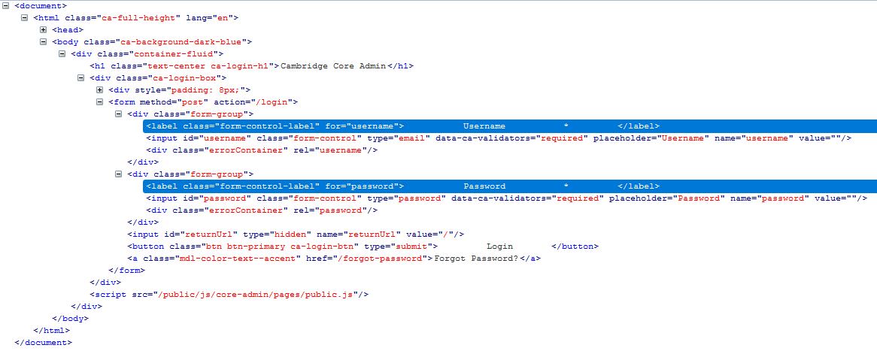
Some Possible Issue using Contains()
//label[contains(@class,'form-control-label')]
//label[contains(@for,'username')]

Slide 22

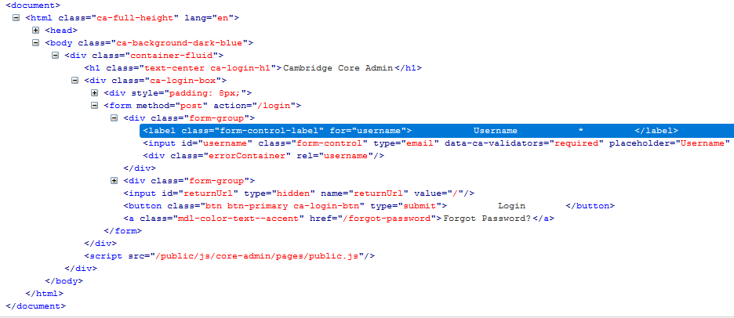
Some Possible Issue using Contains()
//label[contains(@for,'username')]

Slide 23
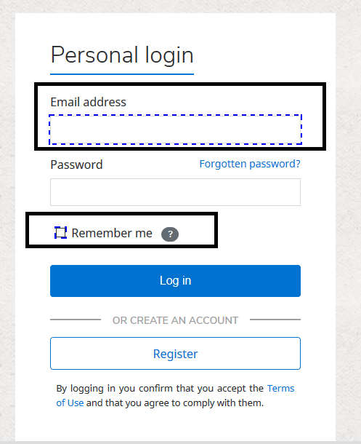
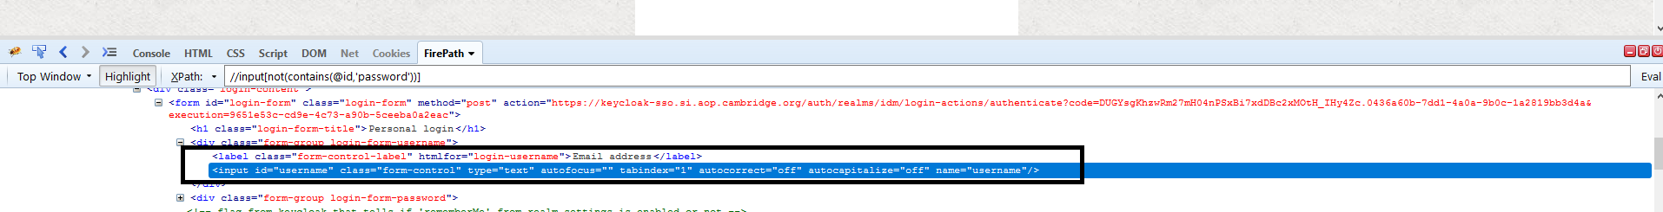
NOT Contains
//input[not(contains(@id,'password'))]

Slide 24
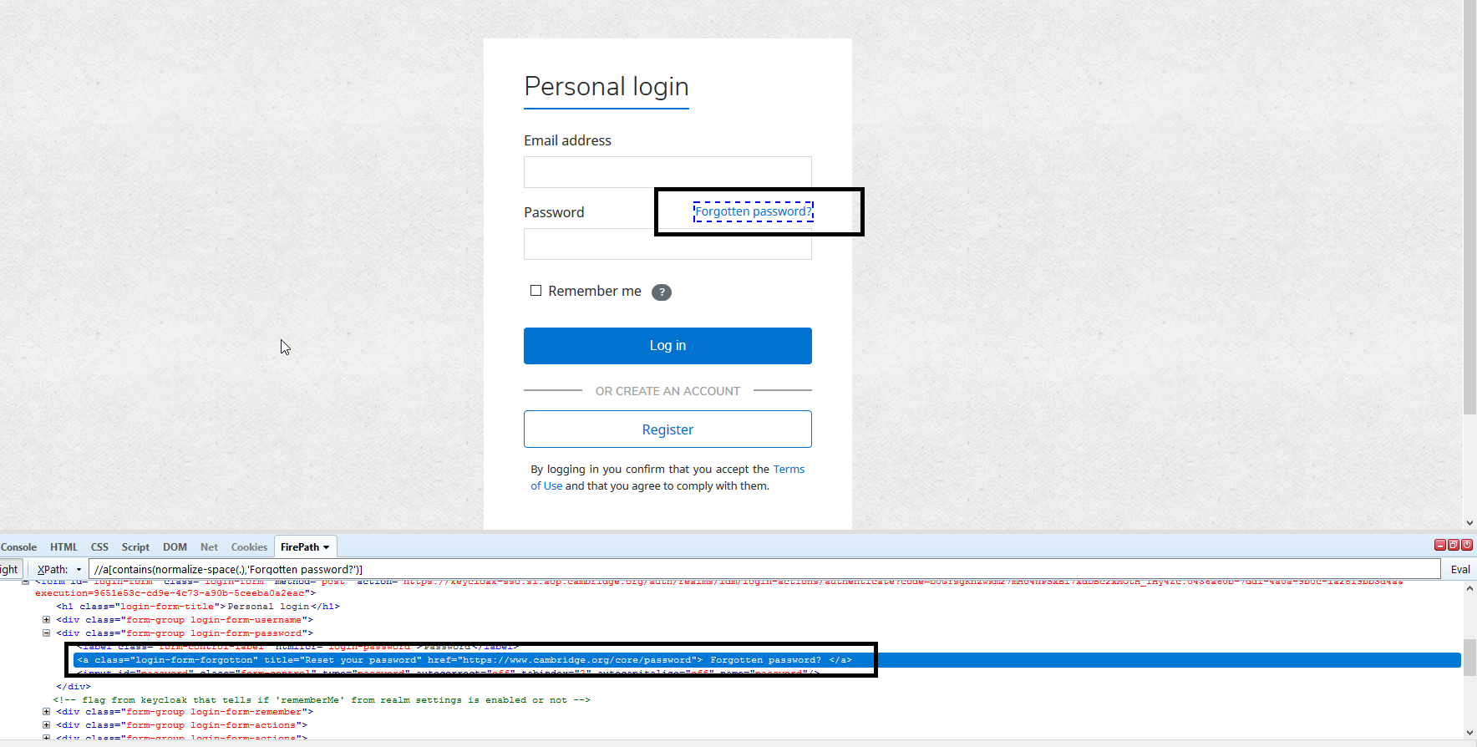
Normalize space
//a[contains(normalize-space(.),'Forgotten password?')]

Slide 25
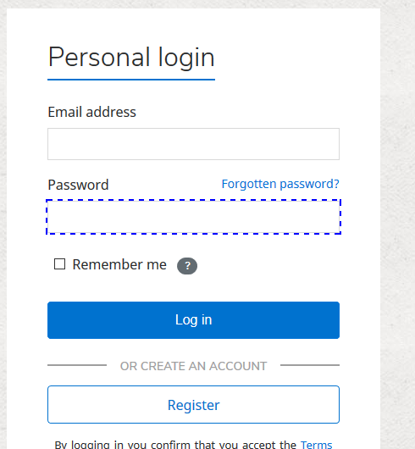
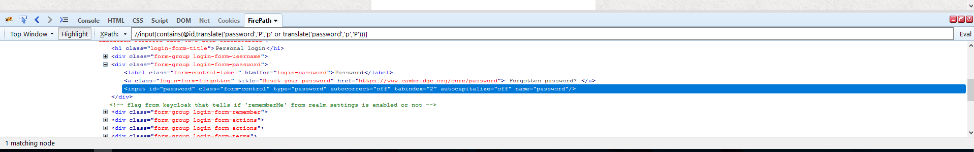
Translate
//input[contains(@id,translate('password','P','p' or translate('password','p','P')))]
Or
//input[contains(@id,translate('password','P','p'))]

Slide 26
Using OR & AND
In OR expression, two conditions are used, whether 1st condition OR 2nd condition should be true. It is also applicable if any one condition is true or maybe both. Means any one condition should be true to find the element.
In AND expression, two conditions are used, both conditions should be true to find the element. It fails to find element if any one condition is false.

Slide 27
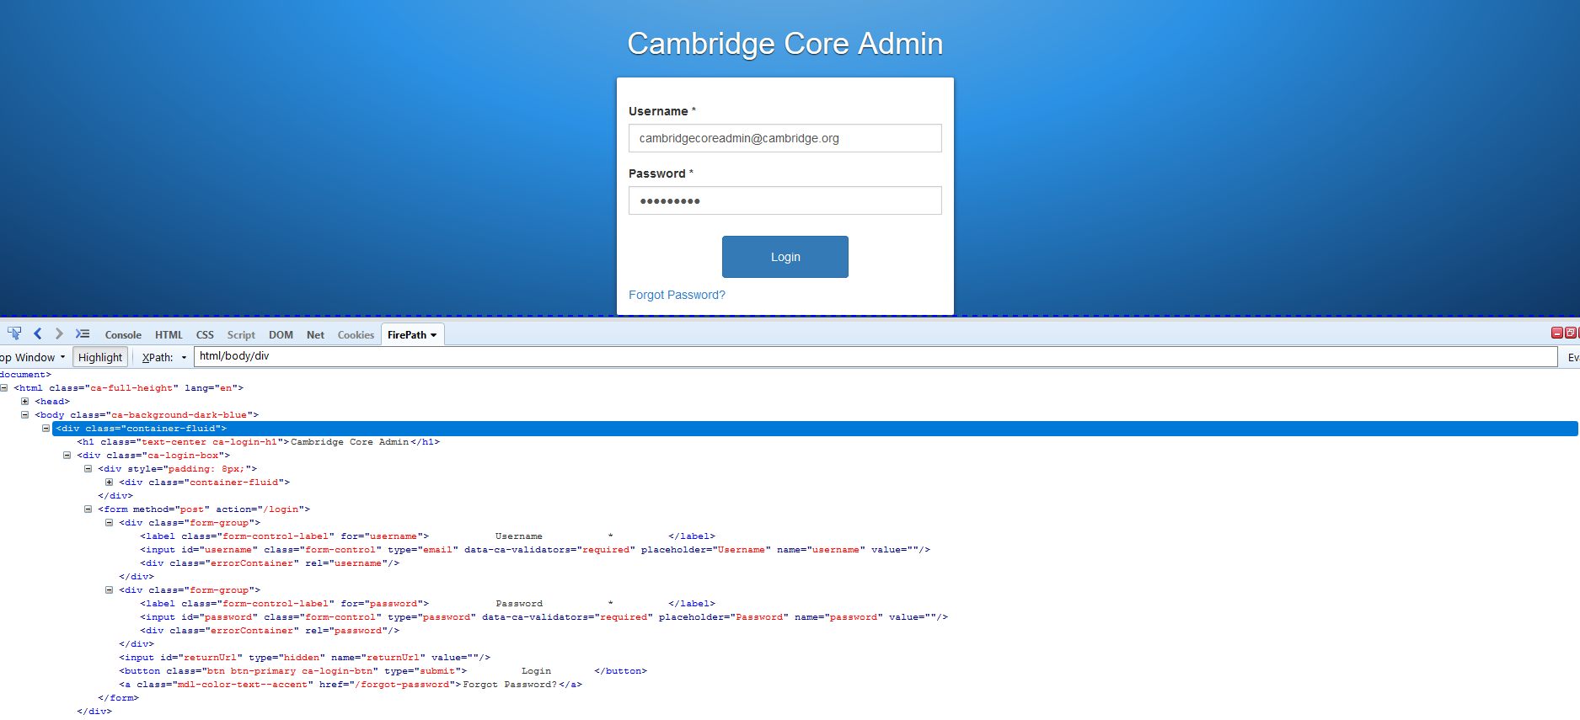
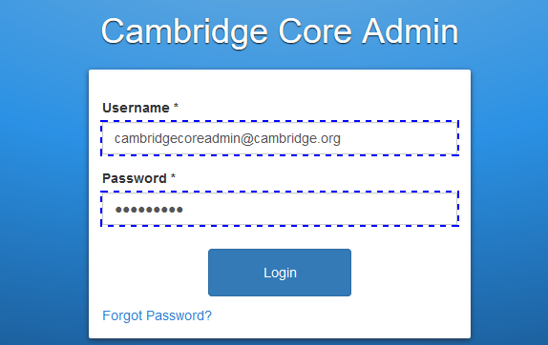
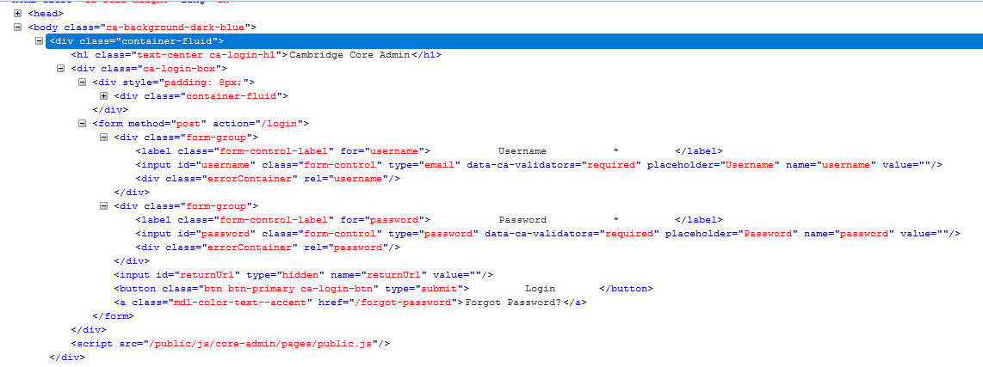
Using OR & AND
//input[@type='email' OR @placeholder='Password']

Slide 28
Using OR & AND
//input[@type='email' AND @placeholder='Password']

Slide 29
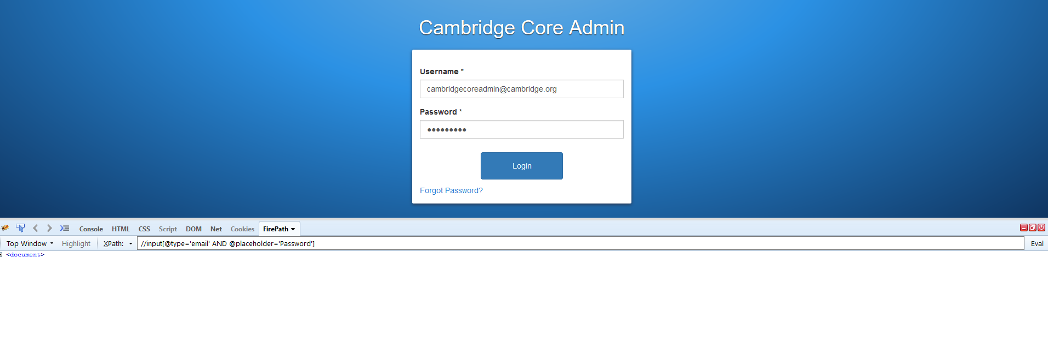
Using OR & AND
//input[@type='email' AND @placeholder=‘Password']

Slide 30
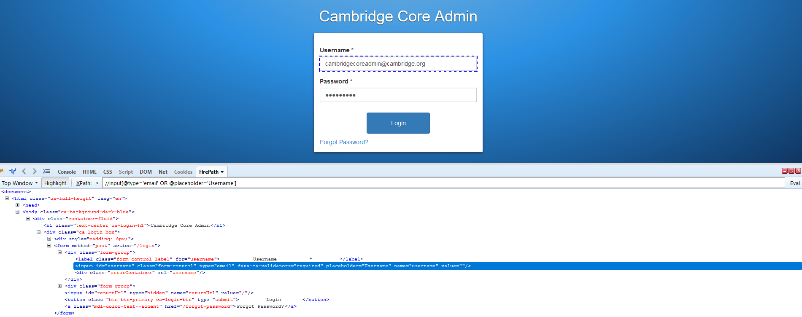
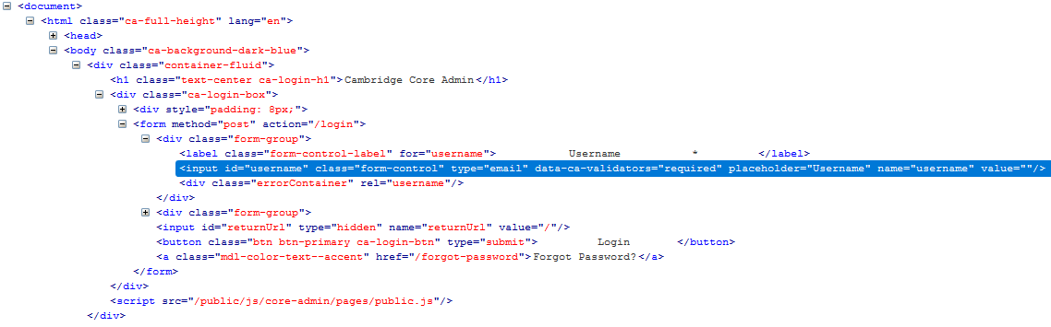
Using OR & AND
//input[@type='email' AND @placeholder='Username']

Slide 31
Start-with function
Start-with function finds the element whose attribute value changes on refresh or any operation on the webpage. In this expression, match the starting text of the attribute is used to find the element whose attribute changes dynamically. You can also find the element whose attribute value is static (not changes).
For example -: Suppose the ID of particular element changes dynamically like:
Id=" message12"
Id=" message345"
Id=" message8769"
CCP Prime example
//div[contains(@class,'flash-message')]//div[starts-with(@class,'alert')]
//div[@class='heading' and starts-with(.,'Permissions')]
//a[contains(@href, 'content/books') and starts-with(.,'Books')]

Slide 32
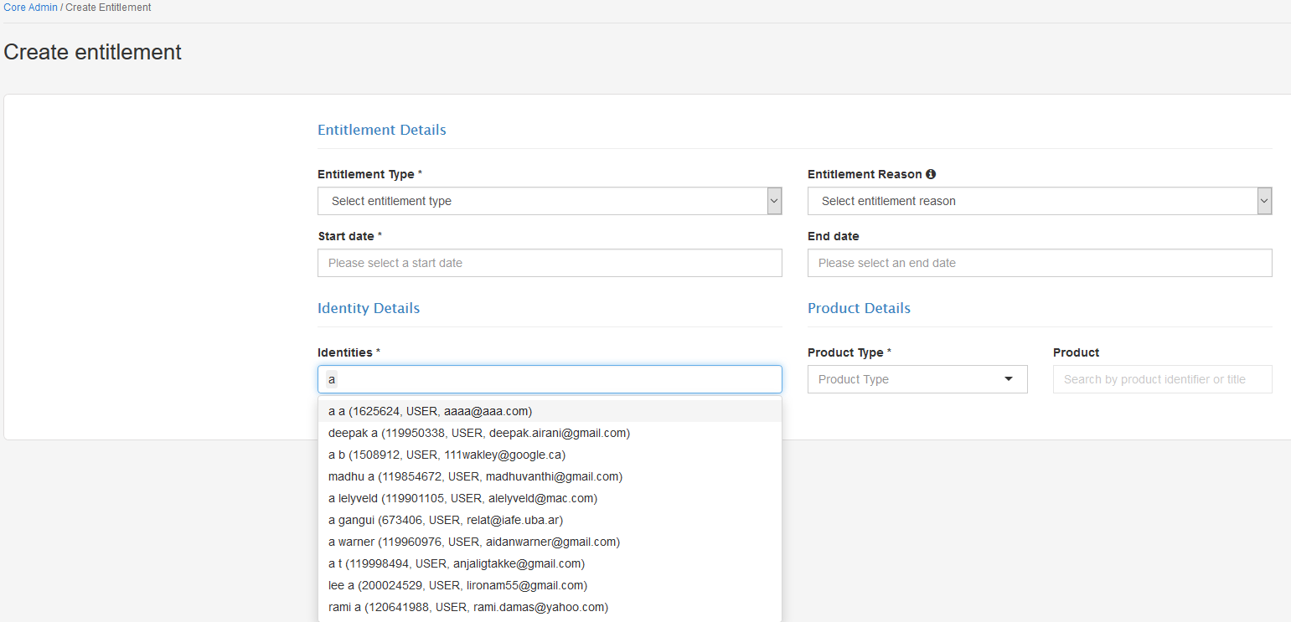
Start-with function

Slide 33
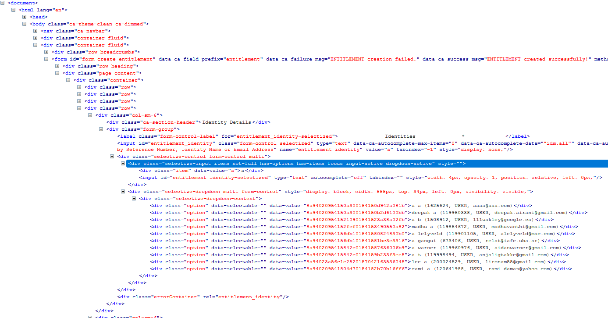
Start-with function

Slide 34
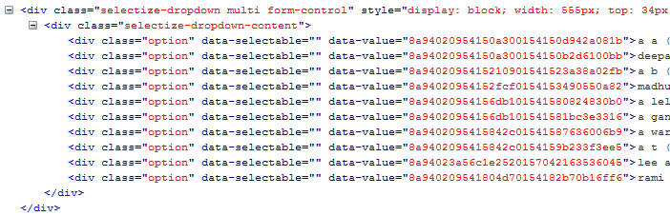
Start-with function
//div[starts-with(@data-value,'8a94020954')]

Slide 35
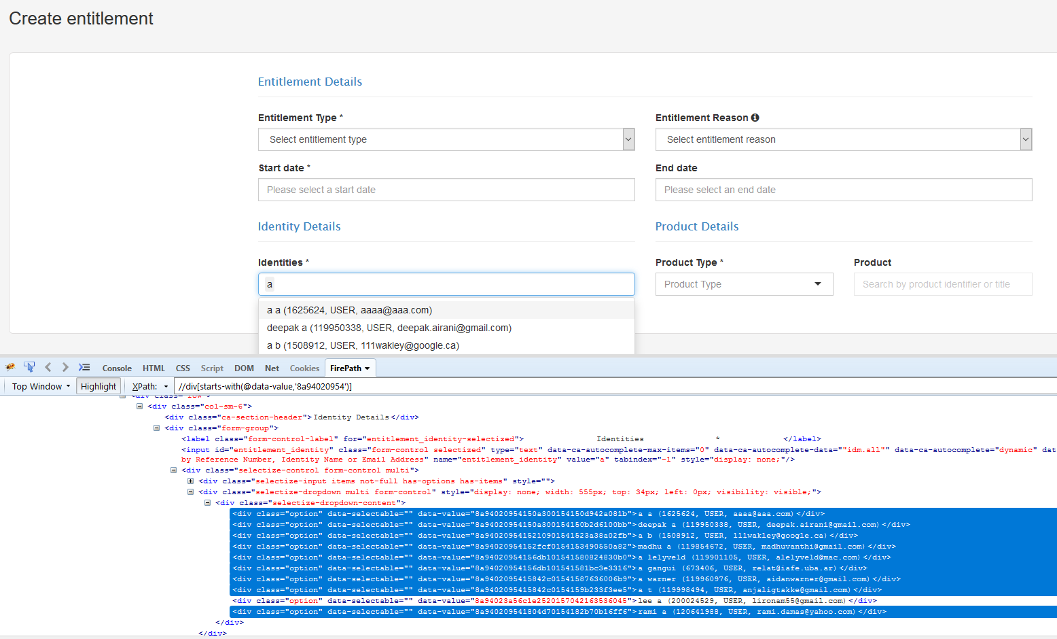
Start-with function

Slide 36
Start-with function
//div[starts-with(@data-value,'8a94020954150a3')]

Slide 37
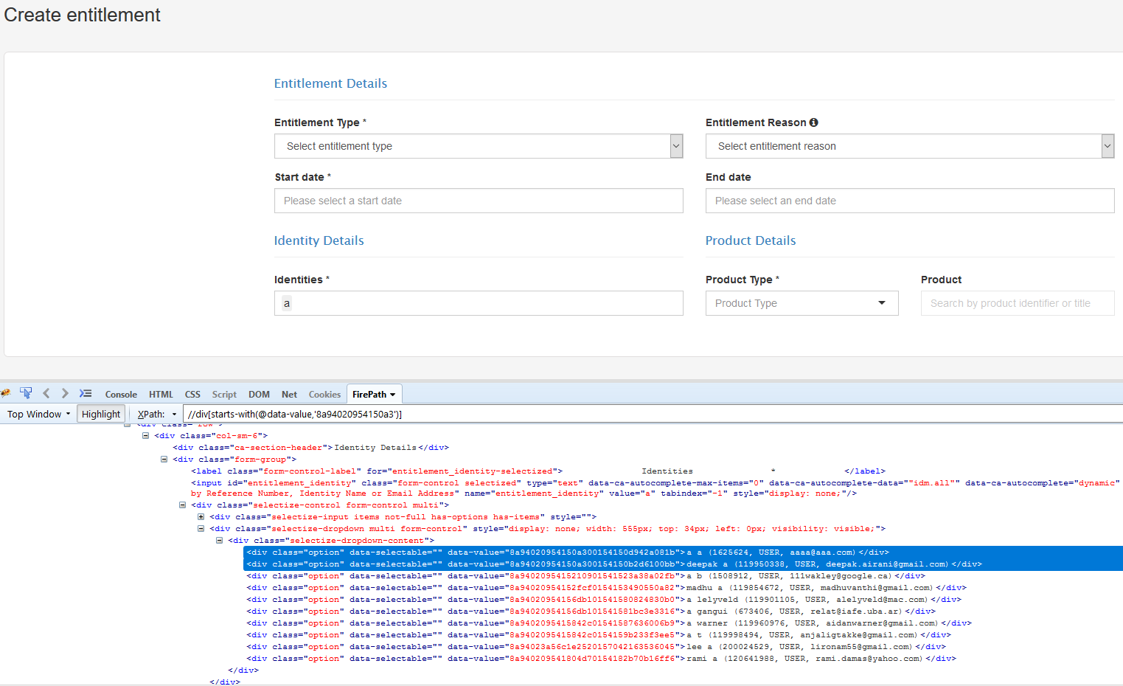
Start-with function

Slide 38
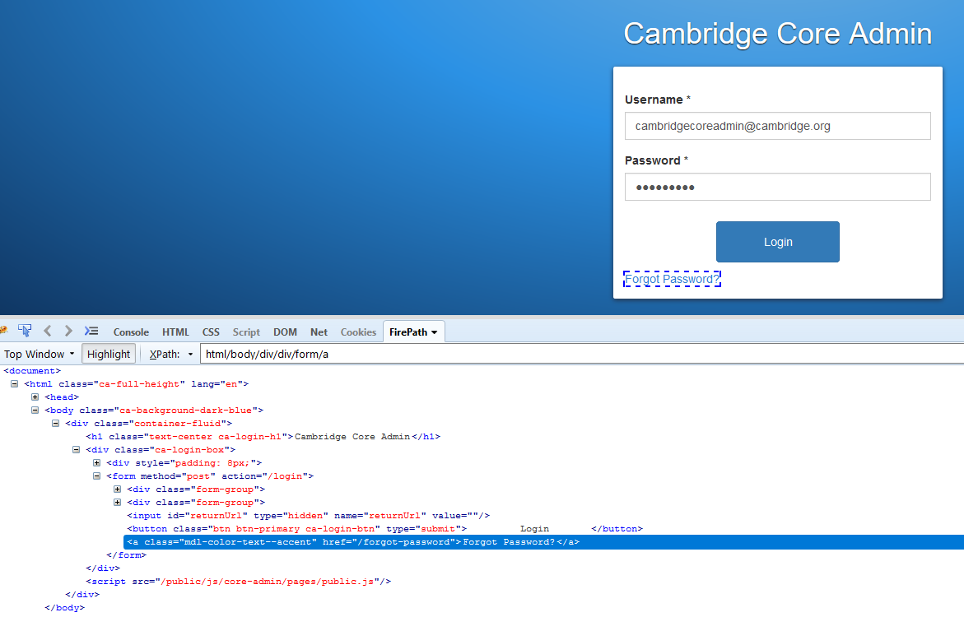
Text ( )
In this expression, with text function, we find the element with exact text match
//a
//a[text()=
//a[text()='Forgot Password?']

Slide 39
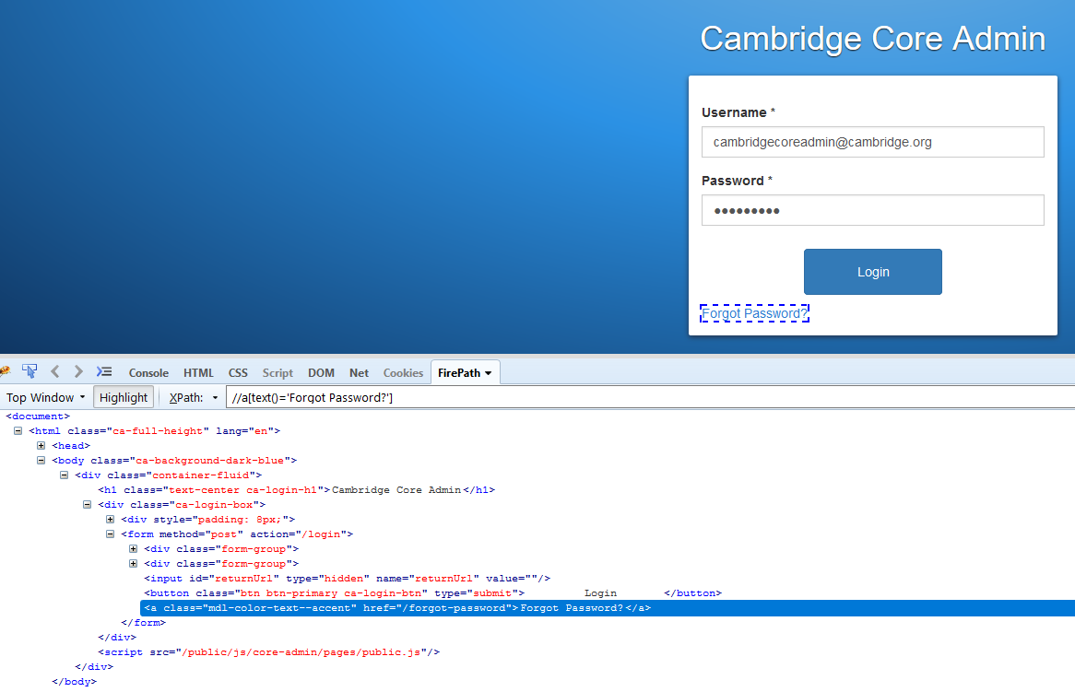
Text ( )

Slide 40
Text ( )

Slide 41
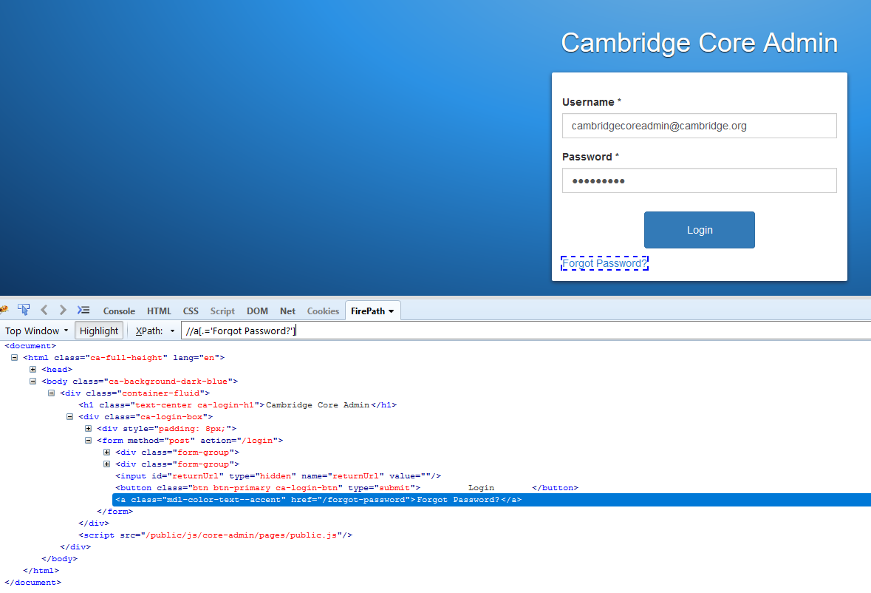
Text ( )
//a[text()='Forgot Password?']
//a[.='Forgot Password?']

Slide 42
XPath axes methods
These XPath axes methods are used to find the complex or dynamic elements.
Following
Ancestor
Child
Preceding
Following-Sibling
Parent
Self
Descendant

Slide 43
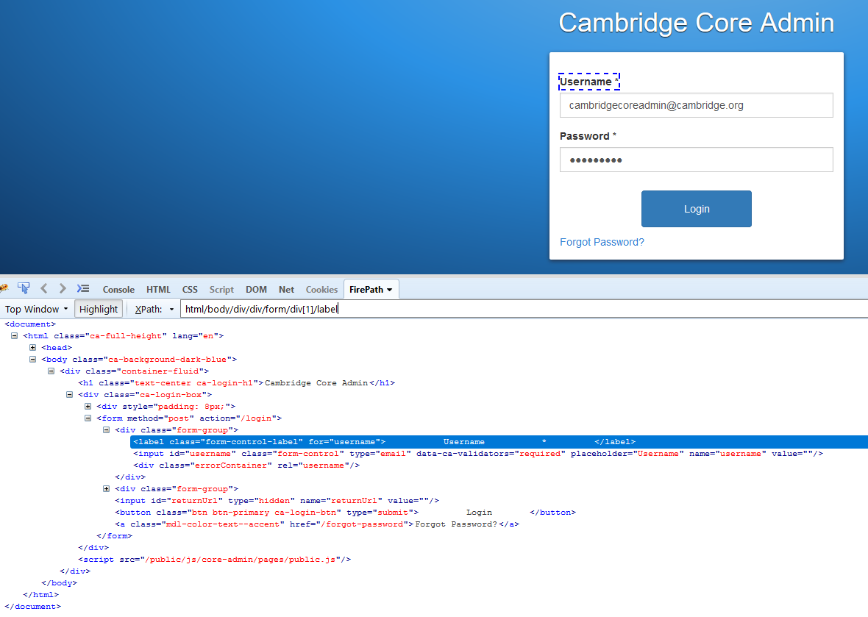
Following
Selects all elements in the document of the current node.

Slide 44
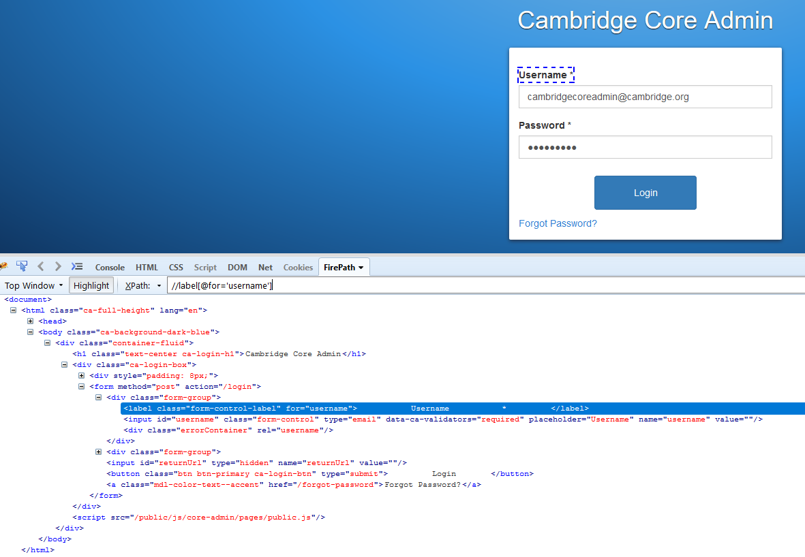
Following
//label[@for='username']
//label[@for='username']//following::input

Slide 45
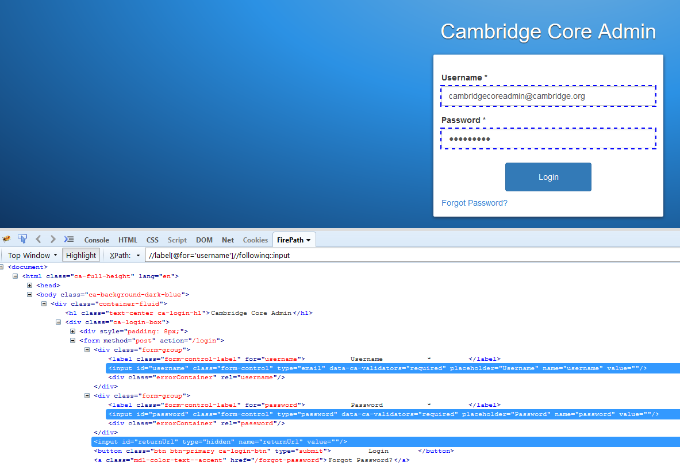
Following
//label[@for='username']//following::div

Slide 46
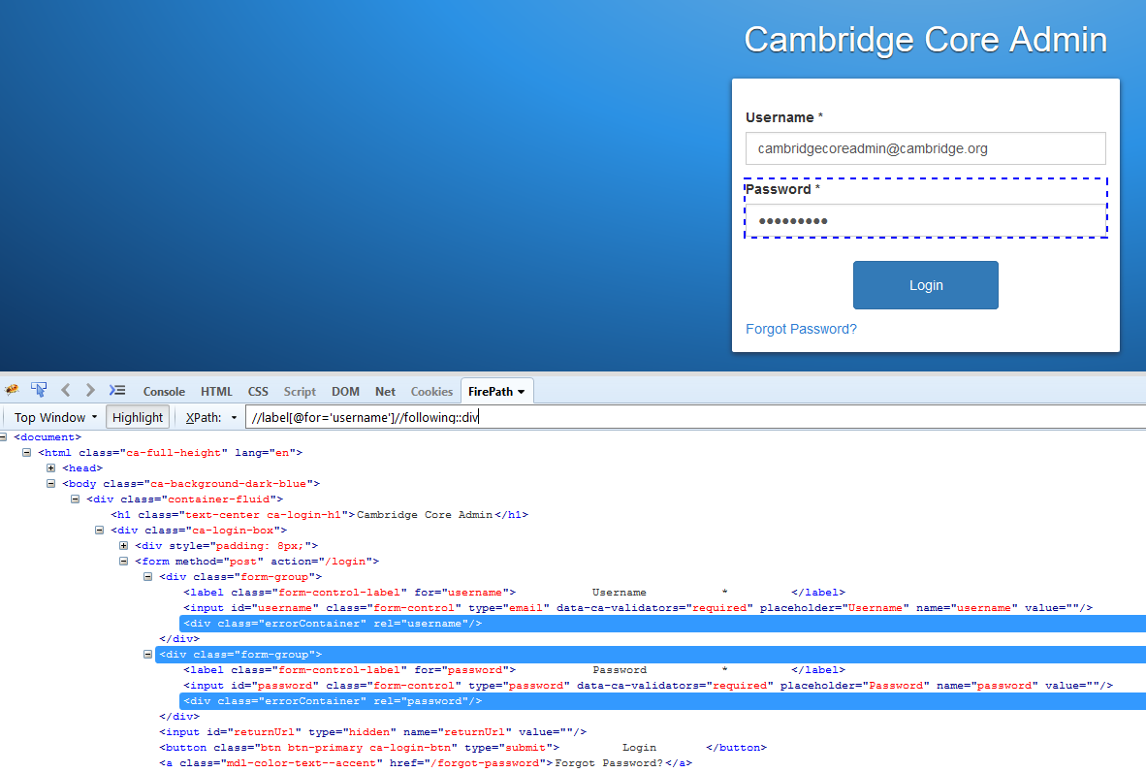
Following

Slide 47
Following
Selects all elements in the document of the current node.

Slide 48
Ancestor
The ancestor axis selects all ancestors element (grandparent, parent, etc.) of the current node
//label[@for='username']//following::input
//label[@for='username']//ancestor::input

Slide 49
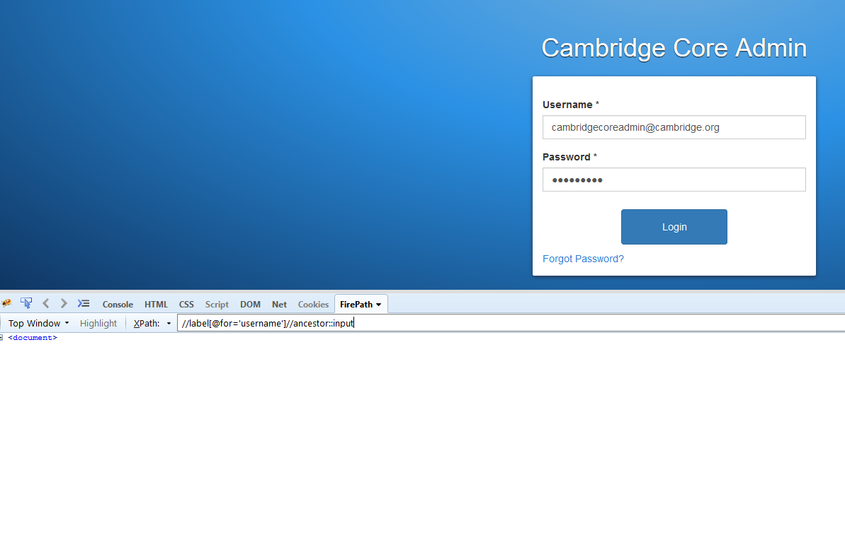
Ancestor
//label[@for='username']//ancestor::input

Slide 50
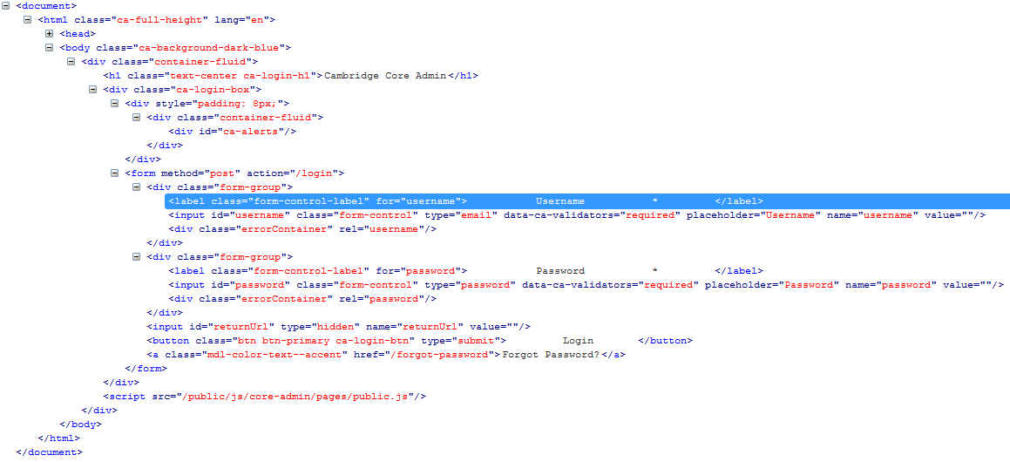
Ancestor
//label[@for='username']//ancestor::input
//label[@for='username']//ancestor::div

Slide 51
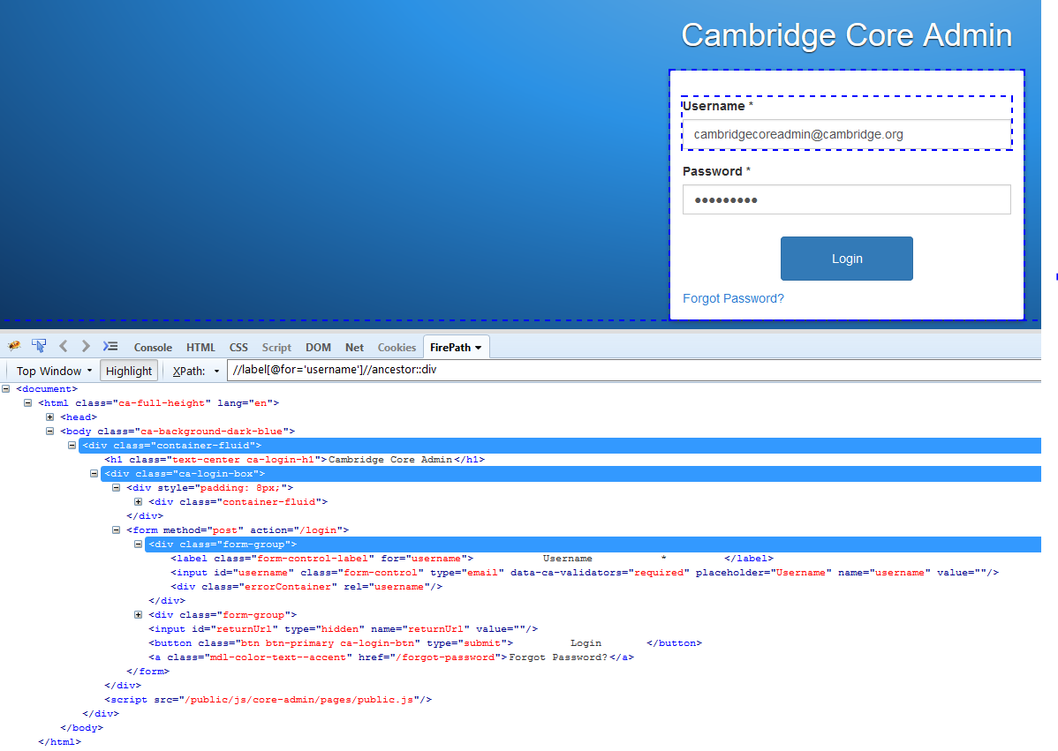
Ancestor
//label[@for='username']//ancestor::div
//label[@for='username']//ancestor::div
[contains(.,'Cambridge Core Admin')]

Slide 52
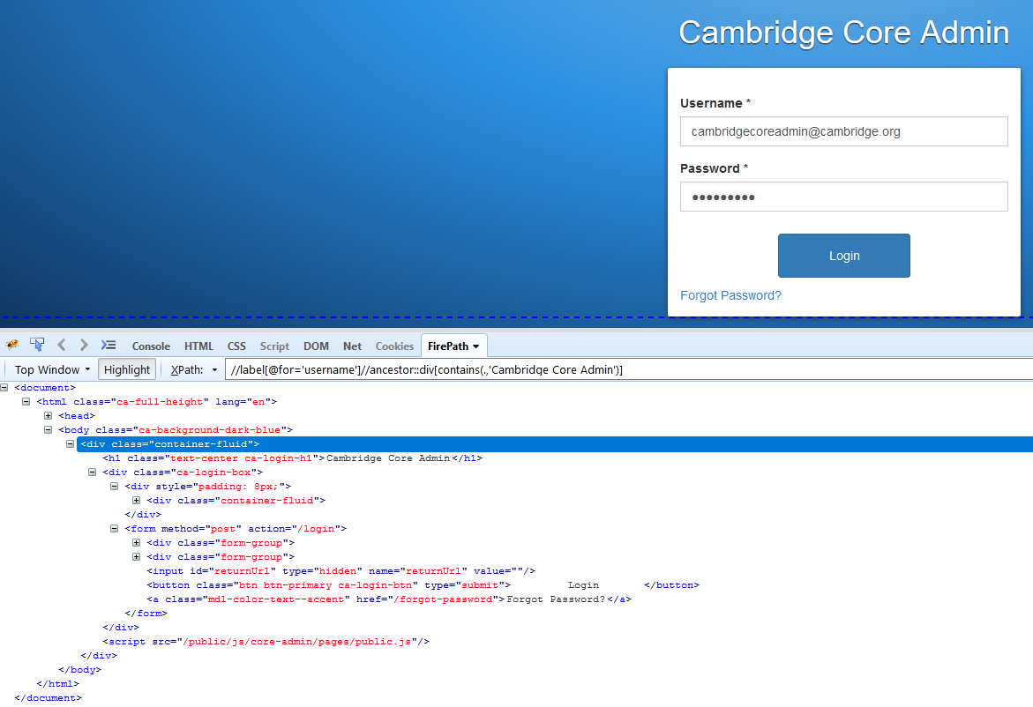
Ancestor
//label[@for='username']//ancestor::div
[contains(.,'Cambridge Core Admin')]

Slide 53
Following
Selects all elements in the document of the current node.
Ancestor
The ancestor axis selects all ancestors element (grandparent, parent, etc.) of the current node

Slide 54
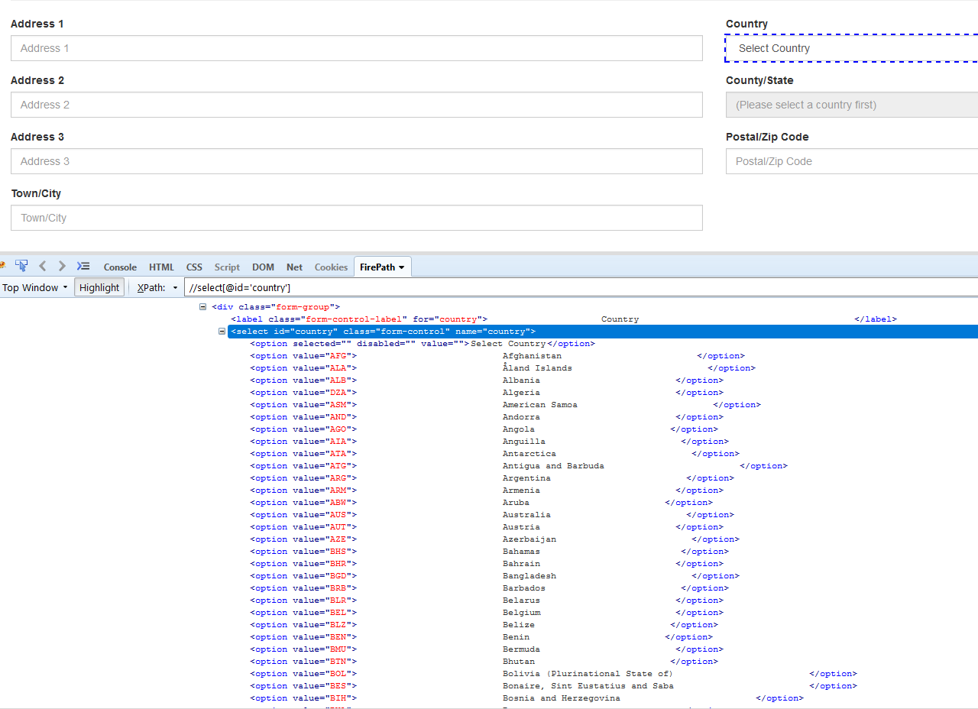
Child
Selects all children elements of the current node (Java) as shown in the below screen.
//select[@id='country']

Slide 55
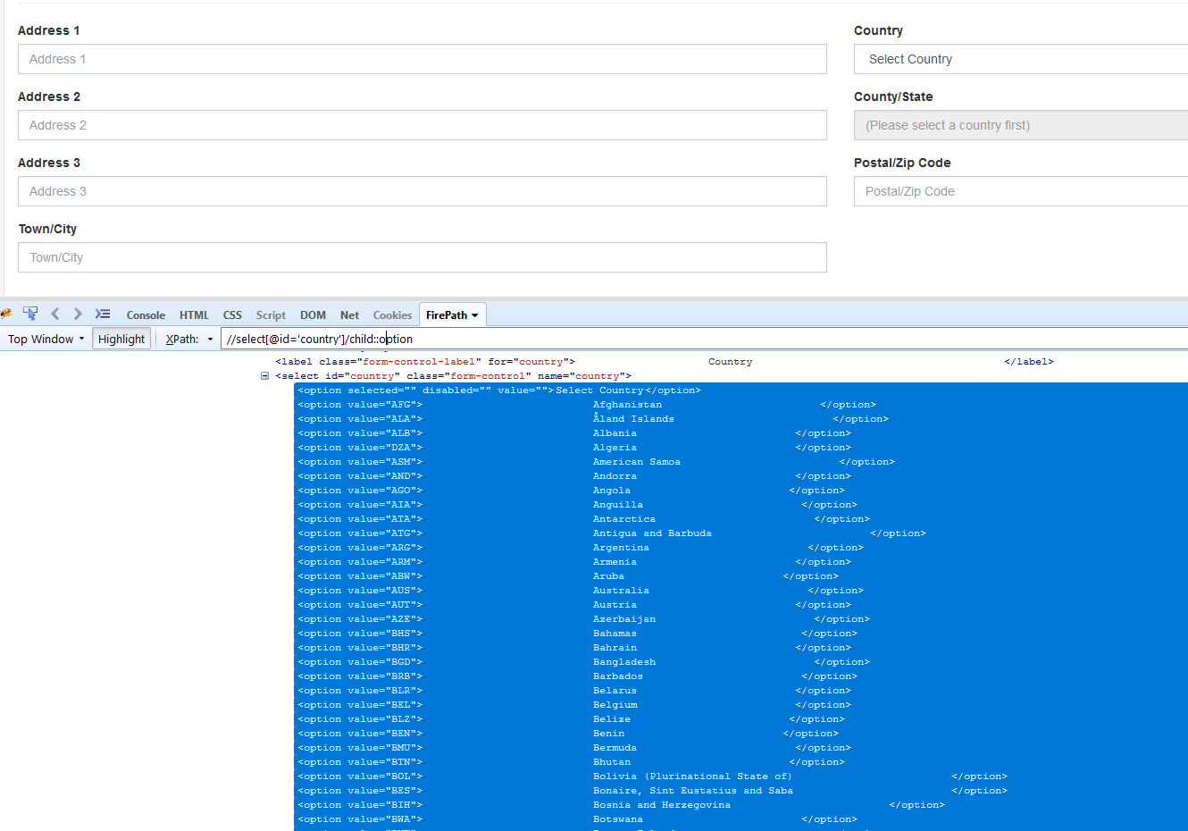
Child
//select[@id='country']/child::option

Slide 56
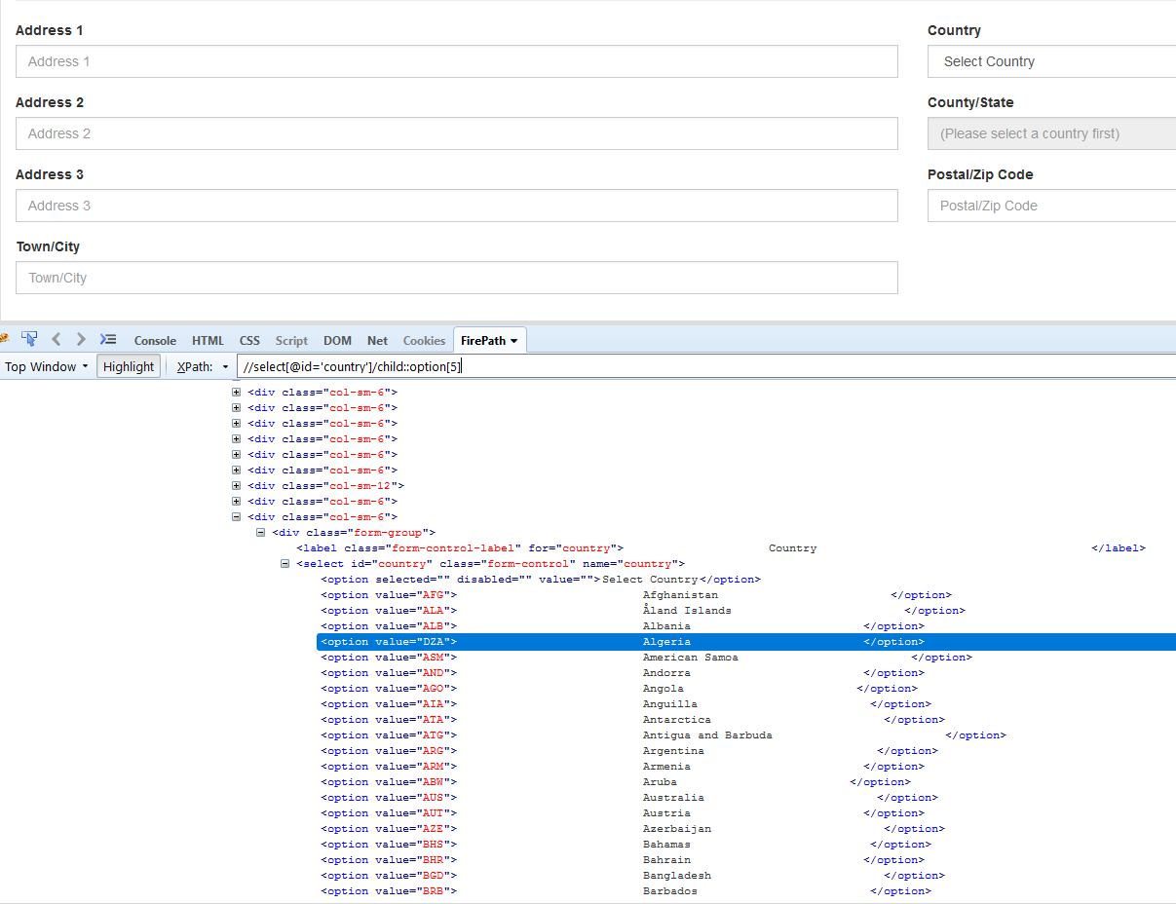
Child
//select[@id='country']/child::option[5]

Slide 57
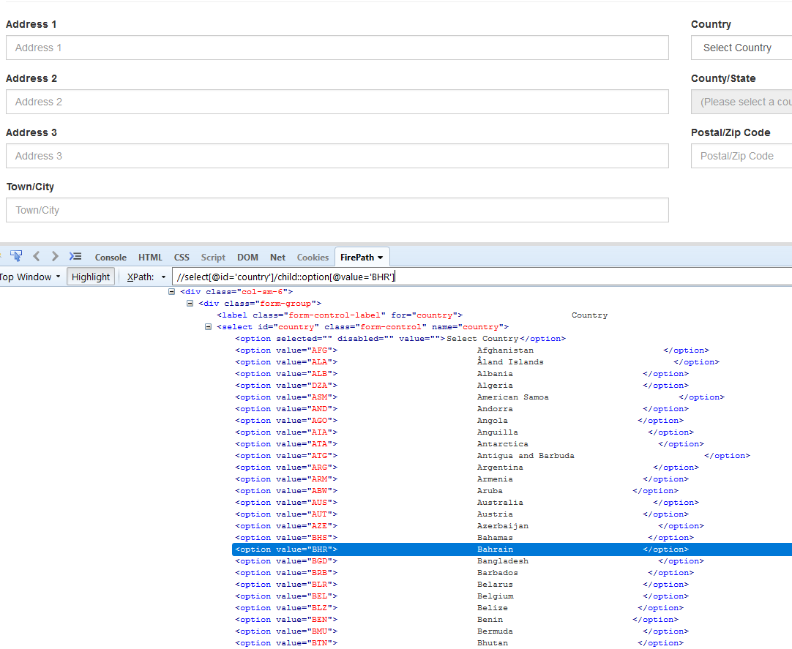
Child
//select[@id='country']/child::option[@value='BHR']

Slide 58
Following
Selects all elements in the document of the current node.
Ancestor
The ancestor axis selects all ancestors element (grandparent, parent, etc.) of the current node
Child
Selects all children elements of the current node (Java) as shown in the below screen.

Slide 59
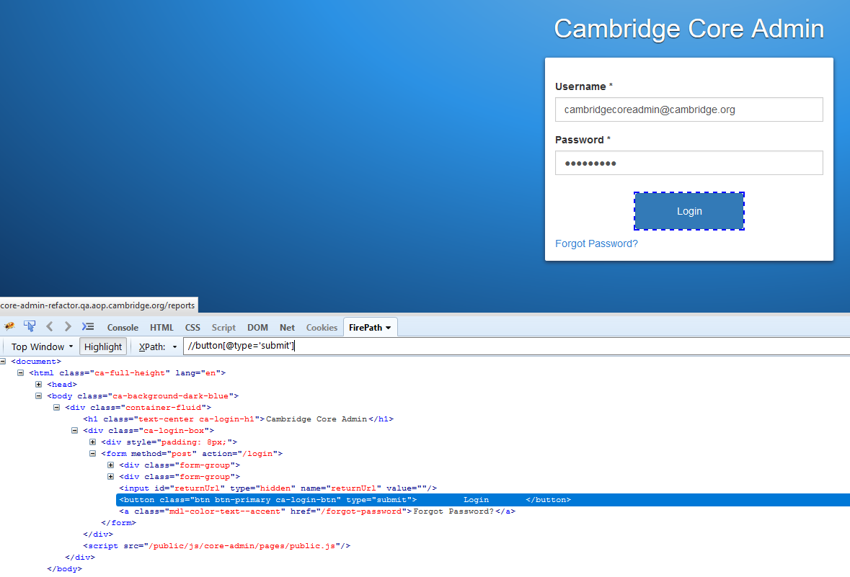
Preceding
Select all nodes that come before the current node.

Slide 60
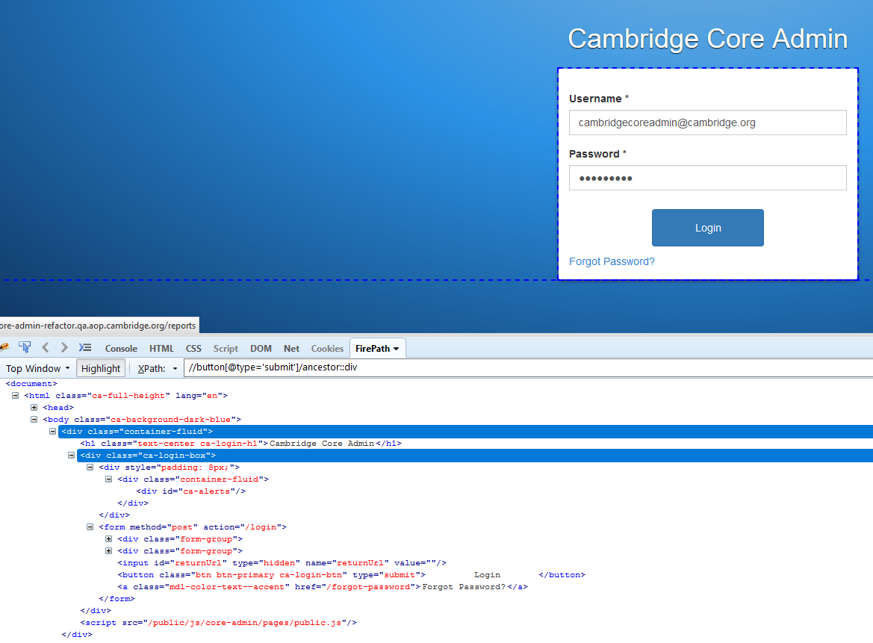
Preceding
//button[@type='submit']/ancestor::div
//button[@type='submit']/ancestor::input

Slide 61
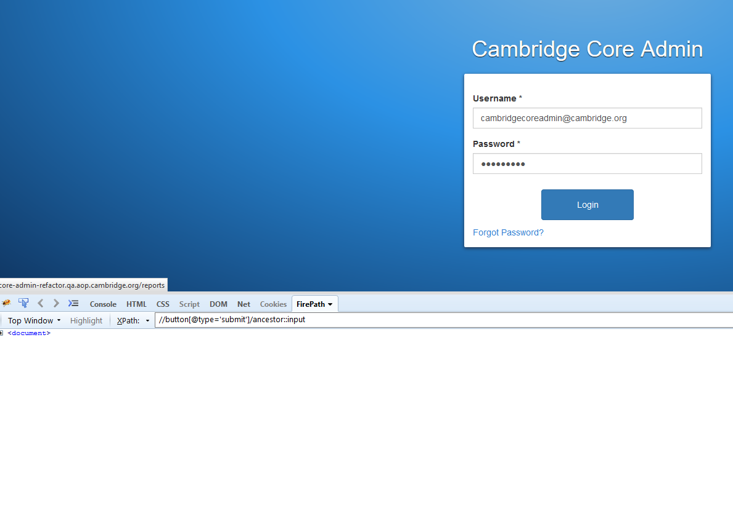
Preceding
//button[@type='submit']/ancestor::input

Slide 62
Preceding
//button[@type='submit']/ancestor::input
//button[@type='submit']/preceding::input

Slide 63
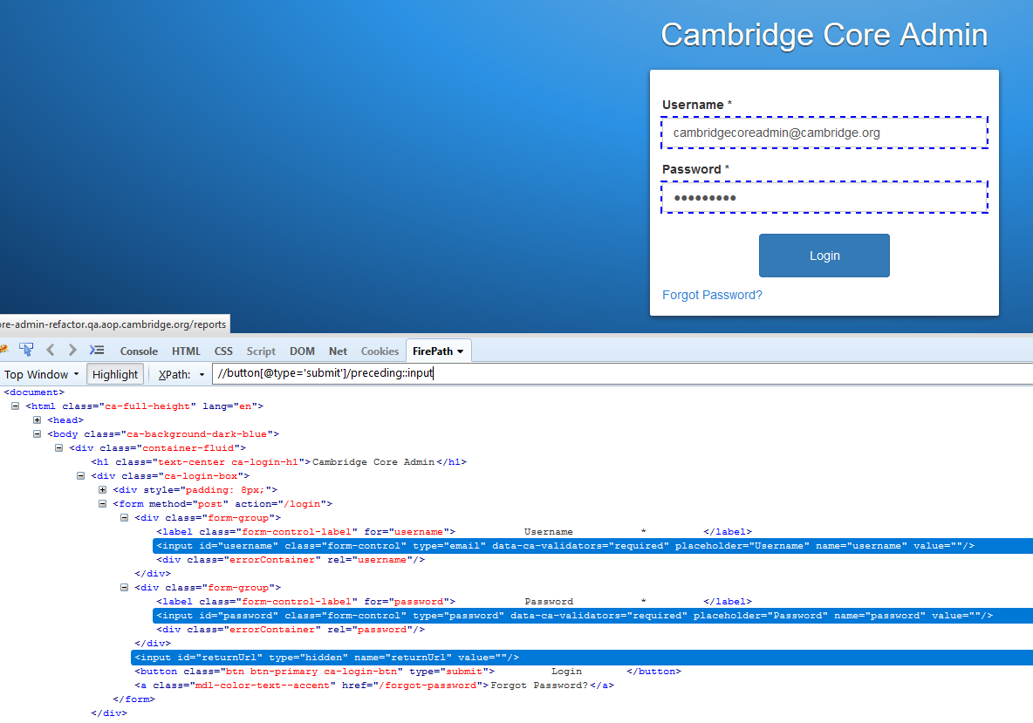
Preceding
//button[@type='submit']/preceding::input

Slide 64

Preceding
//button[@type='submit']/preceding::input[@id=‘username’]

Slide 65

Preceding
//button[@type='submit']/preceding::input[@type='password']

Slide 66
Following
Selects all elements in the document of the current node.
Ancestor
The ancestor axis selects all ancestors element (grandparent, parent, etc.) of the current node
Child
Selects all children elements of the current node (Java) as shown in the below screen.
Preceding
Select all nodes that come before the current node

Slide 67

Following-sibling
Select the following siblings of the context node. Siblings are at the same level of the current node

Slide 68

Following-sibling
//label[@for='referenceNumber']/following-sibling::input

Slide 69

Following-sibling
//label[@for='referenceNumber']/following-sibling::input[@name='referenceNumber']

Slide 70

Following-sibling
//label[@for='referenceNumber']/following-sibling::div

Slide 71
Following
Selects all elements in the document of the current node.
Ancestor
The ancestor axis selects all ancestors element (grandparent, parent, etc.) of the current node
Child
Selects all children elements of the current node (Java) as shown in the below screen.
Preceding
Select all nodes that come before the current node
Following-sibling
Select the following siblings of the context node. Siblings are at the same level of the current node

Slide 72

Parent
Selects the parent of the current node.

Slide 73

Parent
//li[contains(.,'Books')]/parent::ul

Slide 74

Parent
//li[contains(.,'Books')]/parent::ul[@class='nav navbar-nav']

Slide 75
Following
Selects all elements in the document of the current node.
Ancestor
The ancestor axis selects all ancestors element (grandparent, parent, etc.) of the current node
Child
Selects all children elements of the current node (Java) as shown in the below screen.
Preceding
Select all nodes that come before the current node
Following-sibling
Select the following siblings of the context node. Siblings are at the same level of the current node
Parent
Selects the parent of the current node.

Slide 76

Self
Selects the current node or 'self' means it indicates the node itself
//*[@for='counter_identityId-selectized']
//*[@for='counter_identityId-selectized']/self::label

Slide 77

Self
//*[@for='counter_identityId-selectized']/self::label
//*[@for='counter_identityId-selectized']/self::label
//label[@for='counter_identityId-selectized']

Slide 78
Following
Selects all elements in the document of the current node.
Ancestor
The ancestor axis selects all ancestors element (grandparent, parent, etc.) of the current node
Child
Selects all children elements of the current node (Java) as shown in the below screen.
Preceding
Select all nodes that come before the current node
Following-sibling
Select the following siblings of the context node. Siblings are at the same level of the current node
Parent
Selects the parent of the current node.
Self
Selects the current node or 'self' means it indicates the node itself

Slide 79

Descendant
Selects the descendants of the current node
//ul[@class='nav navbar-nav']
//ul[@class='nav navbar-nav']/descendants::li

Slide 80

Descendant
Selects the descendants of the current node
//ul[@class='nav navbar-nav']/descendant::li
//ul[@class='nav navbar-nav']/li

Slide 81

Descendant
Selects the descendants of the current node
//ul[@class='nav navbar-nav']/li

Slide 82
Descendant
//ul[@class='nav navbar-nav']/descendant::li
//ul[@class='nav navbar-nav']/li

Slide 83

.//*[@id='books']/tbody/tr[1]/td[9]/a
//a[contains(.,'View')]

Slide 84

//a[contains(.,'View')]
(//a[contains(.,'View')])[1]

Slide 85

(//a[contains(.,'View')])[1]

